Slide 1
How to sign documents using your PIV Card

Slide 2
Important Tip:
Before you open the Adobe Program, ensure your PIV Card is inserted.

Slide 3
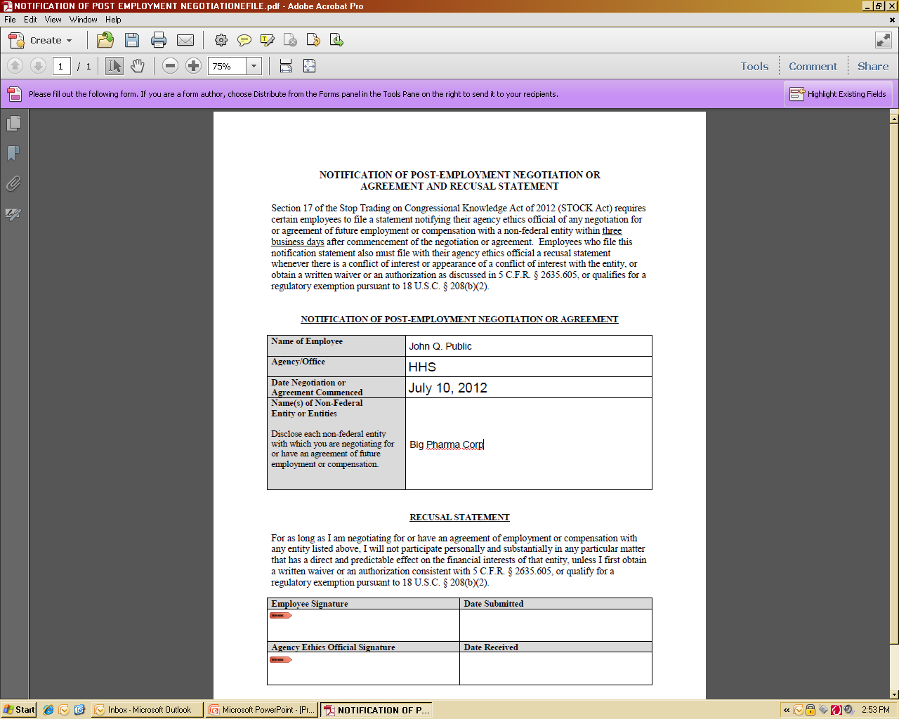
Ensure you are using the Adobe Program and not the Adobe or Acrobat Reader.
Important Tip:
Before you open the Adobe Program, ensure your PIV Card is inserted.

Slide 4
Next, complete the form by filling out the required fields in the form.
Important Tip:
Before you open the Adobe Program, ensure your PIV Card is inserted.

Slide 5
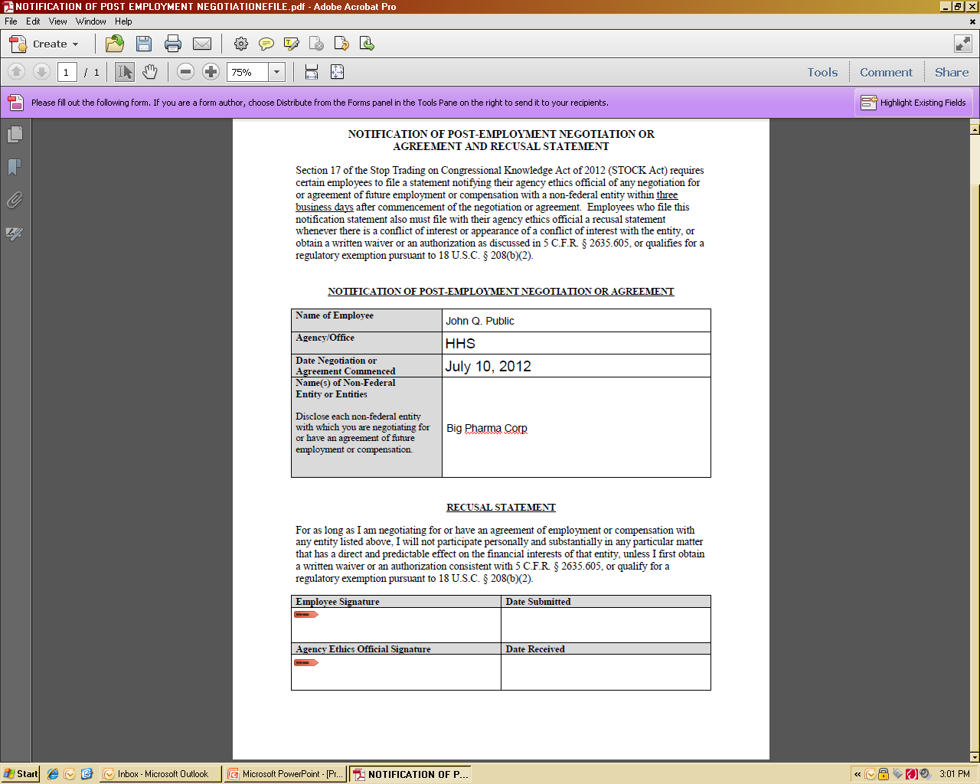
Once the required fields are completed, it is now ready to E-sign. To begin, left-double click here. There may be a small delay.
Important Tip:
Before you open the Adobe Program, ensure your PIV Card is inserted.

Slide 6
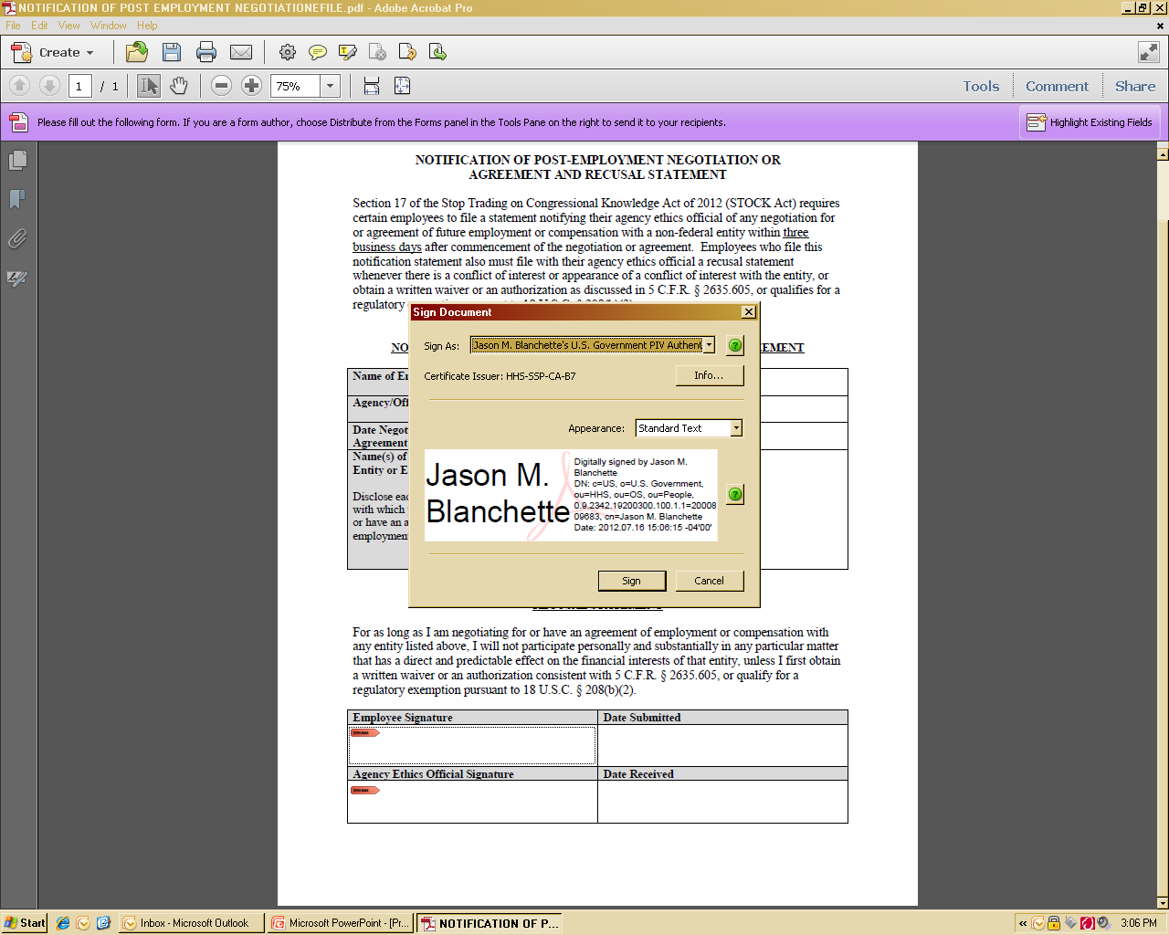
A sign document popup will appear. This is directly connected to your PIV card which contains all of your HHS credentials. Single left-click ‘sign’. There may be a small delay.
John Q. Public
Important Tip:
Before you open the Adobe Program, ensure your PIV Card is inserted.

Slide 7
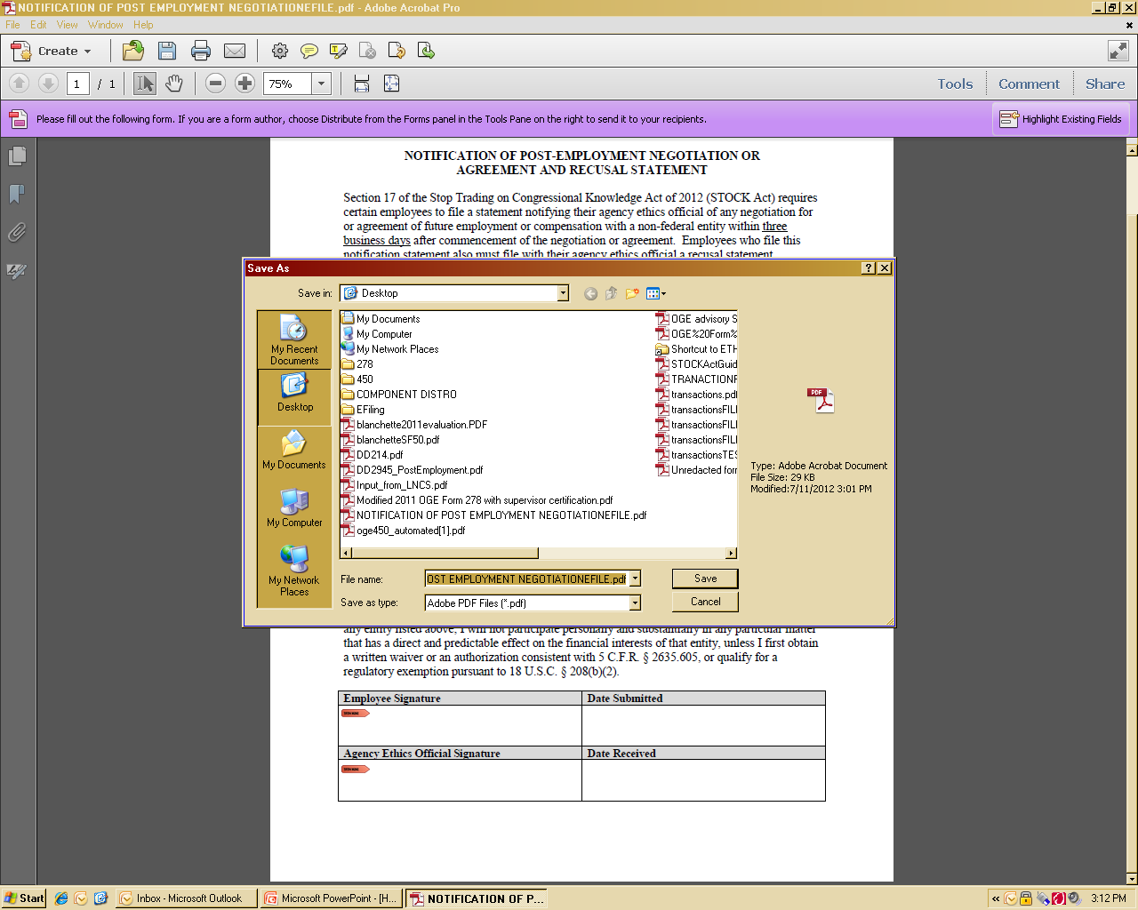
Another window will appear, prompting the user to save the document. It is recommended it is saved using a different name.
Q: Why does this prompt me to save it?
A: Because it will allow you to keep an electronic copy with your signature for your records.
Important Tip:
Before you open the Adobe Program, ensure your PIV Card is inserted.

Slide 8
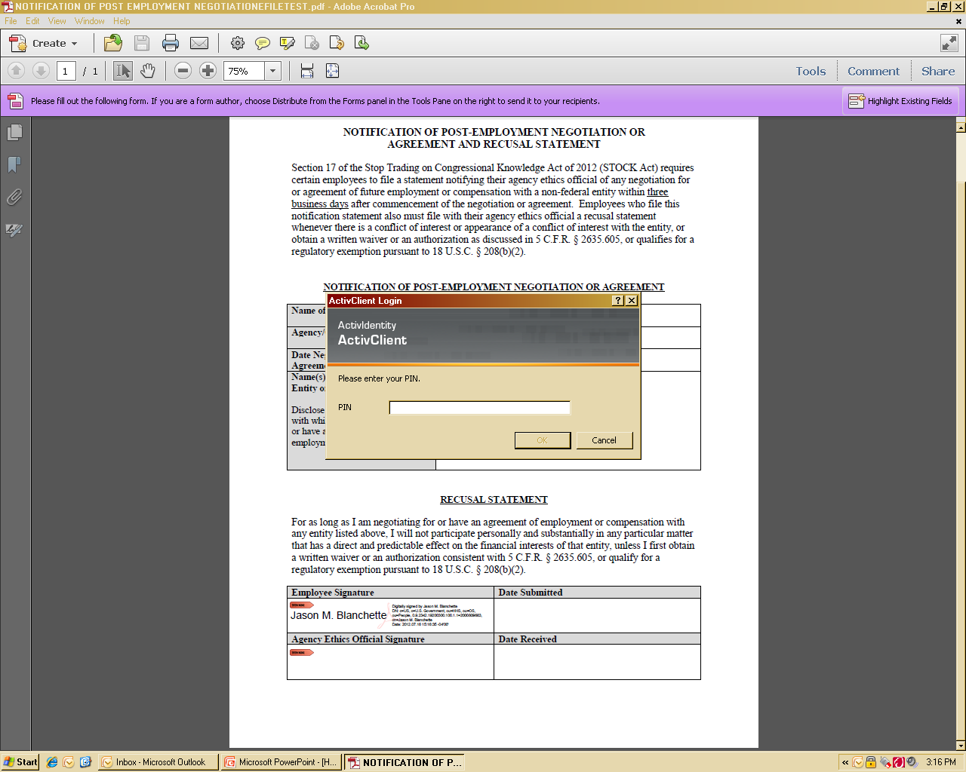
Next, the user will be prompted to put in their PIV card number (usually 4-8 numeric characters long); then click ‘ok’.
John Q. Public
Important Tip:
Before you open the Adobe Program, ensure your PIV Card is inserted.

Slide 9
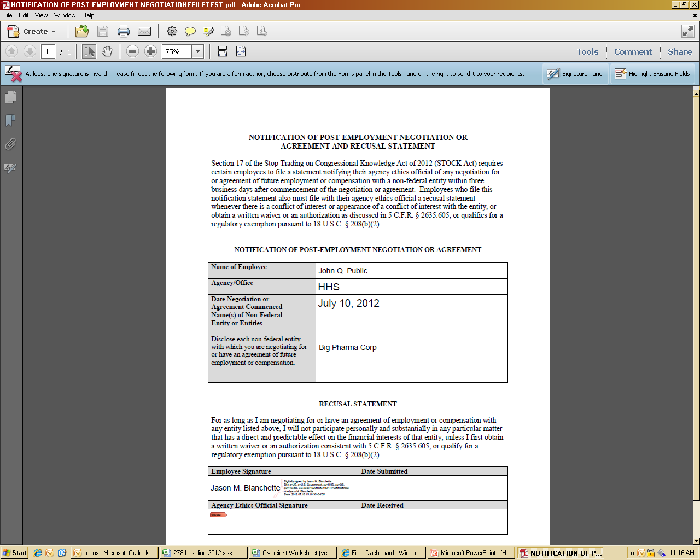
The document is now signed and ready for submission. Note the date and time also appear as part of your PIV signature.
John Q. Public
John Q. Public
Important Tip:
Before you open the Adobe Program, ensure your PIV Card is inserted.

Slide 10
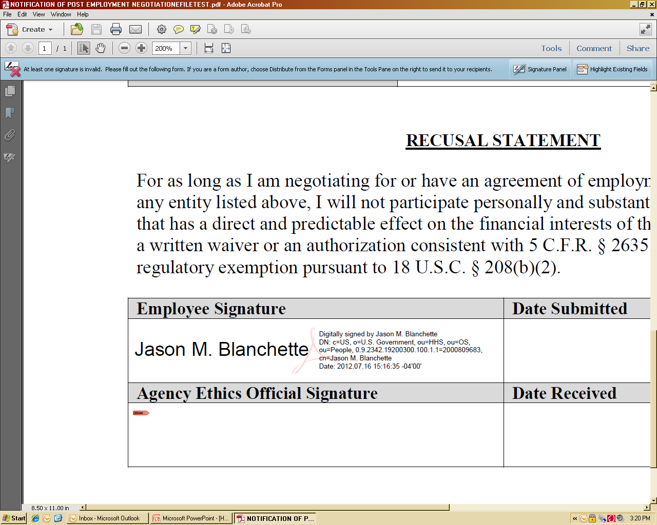
The document is now signed and ready for submission. Note the date and time also appear as part of your PIV signature.
John Q. Public
John Q. Public
Important Tip:
Before you open the Adobe Program, ensure your PIV Card is inserted.

