Slide 1
Conflict of Interest
Policy Implementation
October 23, 2014

Slide 2
Conflict of Interest
Revised and streamlined SOP 21 “Conflict of Interest Requirements for Researchers and Research Staff”, and revised “A Guide to avoiding Financial and Non-financial Conflicts or Perceived Conflicts of Interest in Clinical Research at NIH (October 2014)”.
Effective for DEC submissions as of 10/27/2014
Changes:
  Fewer protocols require COI review
  Possibly more people must be reviewed
  Certification forms for people who don’t file financial disclosure

Slide 3
COI assessment only for “Covered protocols”
“Covered” protocols involve interests that may lead to the financial benefit or loss to any individual or entity. This includes studies:
  of investigational drugs and devices
  whose research question involves a commercially available drug or device
  involving a CRADA or Clinical Trials Agreement
  involving collaboration with a substantially affected organization, or
  involving intellectual property
Substantially Affected Organization (SAO): A biotechnology or pharmaceutical company, a medical device manufacturer; or a corporation, partnership, or other enterprise or entity significantly involved, directly or through subsidiaries, in the research, development, or manufacture of biotechnological, biostatistical, pharmaceutical, or medical devices, equipment, preparations, treatments, or products (5 CFR § 5501.109(b)(10)).

Slide 4
COI assessment only for “Covered individuals”
“Covered” individuals—those persons that may realize financial benefit or loss as a result of participation in the protocol. Covered individuals include:
Personnel who have independent decisional roles in conducting a covered research protocol. These individuals are influential in the design, direction, or conduct of a covered research protocol, or engaged in the analysis or interpretation of data.
The principal investigator, personnel whose resume or CV is provided to a sponsor, personnel listed on an FDA 1572 Form, and personnel who obtain informed consent or who make decisions about research eligibility.
Others who have decisional responsibilities as above, e.g. as co-investigator, research nurse, associate investigators, or an individual who interprets or analyzes research data.

Slide 5
Who is not a “covered individual?”
Individuals who participate only through isolated tasks that are incidental to the research (for example, scheduling patient tests), and those individuals who support research of many protocols through the performance of routine patient care tasks are not covered individuals
E.g. Technicians, phlebotomists, Office of Patient Recruitment and Public Liaison (PRPL), or those screening for multiple protocols

Slide 6
Implementation: OHSRP
Field questions and brief IC staff so that they can handle questions
Brief DECs
Review/revise COI consent language
Review ethics website for consistency

Slide 7
Implementation: PI responsibility
The PI should determine which of these four categories apply to an investigator or staff member:
  Category 1: NIH employee who files a financial disclosure statement; If the investigators are not aware of their financial filing status, the PI should contact his/her Deputy Ethics Counselor (DEC) and inquire about their status. For a list of DECs: https://ethics.od.nih.gov/decs.pdf.
  Category 2: NIH employee who does not file a financial disclosure statement
  Category 3: Federal employee, but not an NIH employee
  Category 4: Not a Federal employee

Slide 8
Implementation: PI responsibility
Category 1: If the individual is a “filer,” no further action is required
Category 2: NIH, non-filer: The PI will request that a certification be completed by the covered individual
Category 3: Fed employee, non-NIH: No action needed (they abide by their agency COI policy)
Category 4: Non-Fed: The PI will request that a certification be completed by the covered individual

Slide 9
Certification for non-Federal Employees

Slide 10
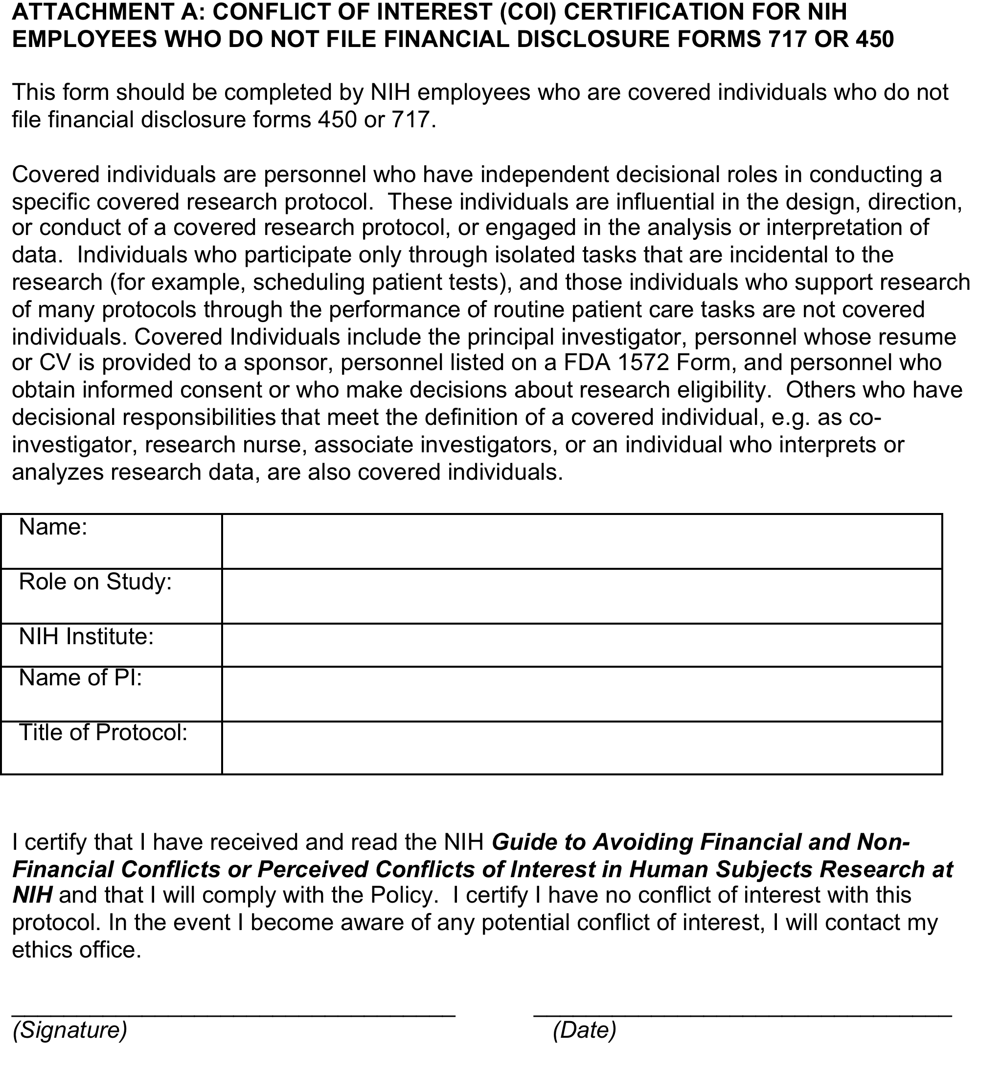
Certification for NIH employees who do not file financial disclosure forms

Slide 11
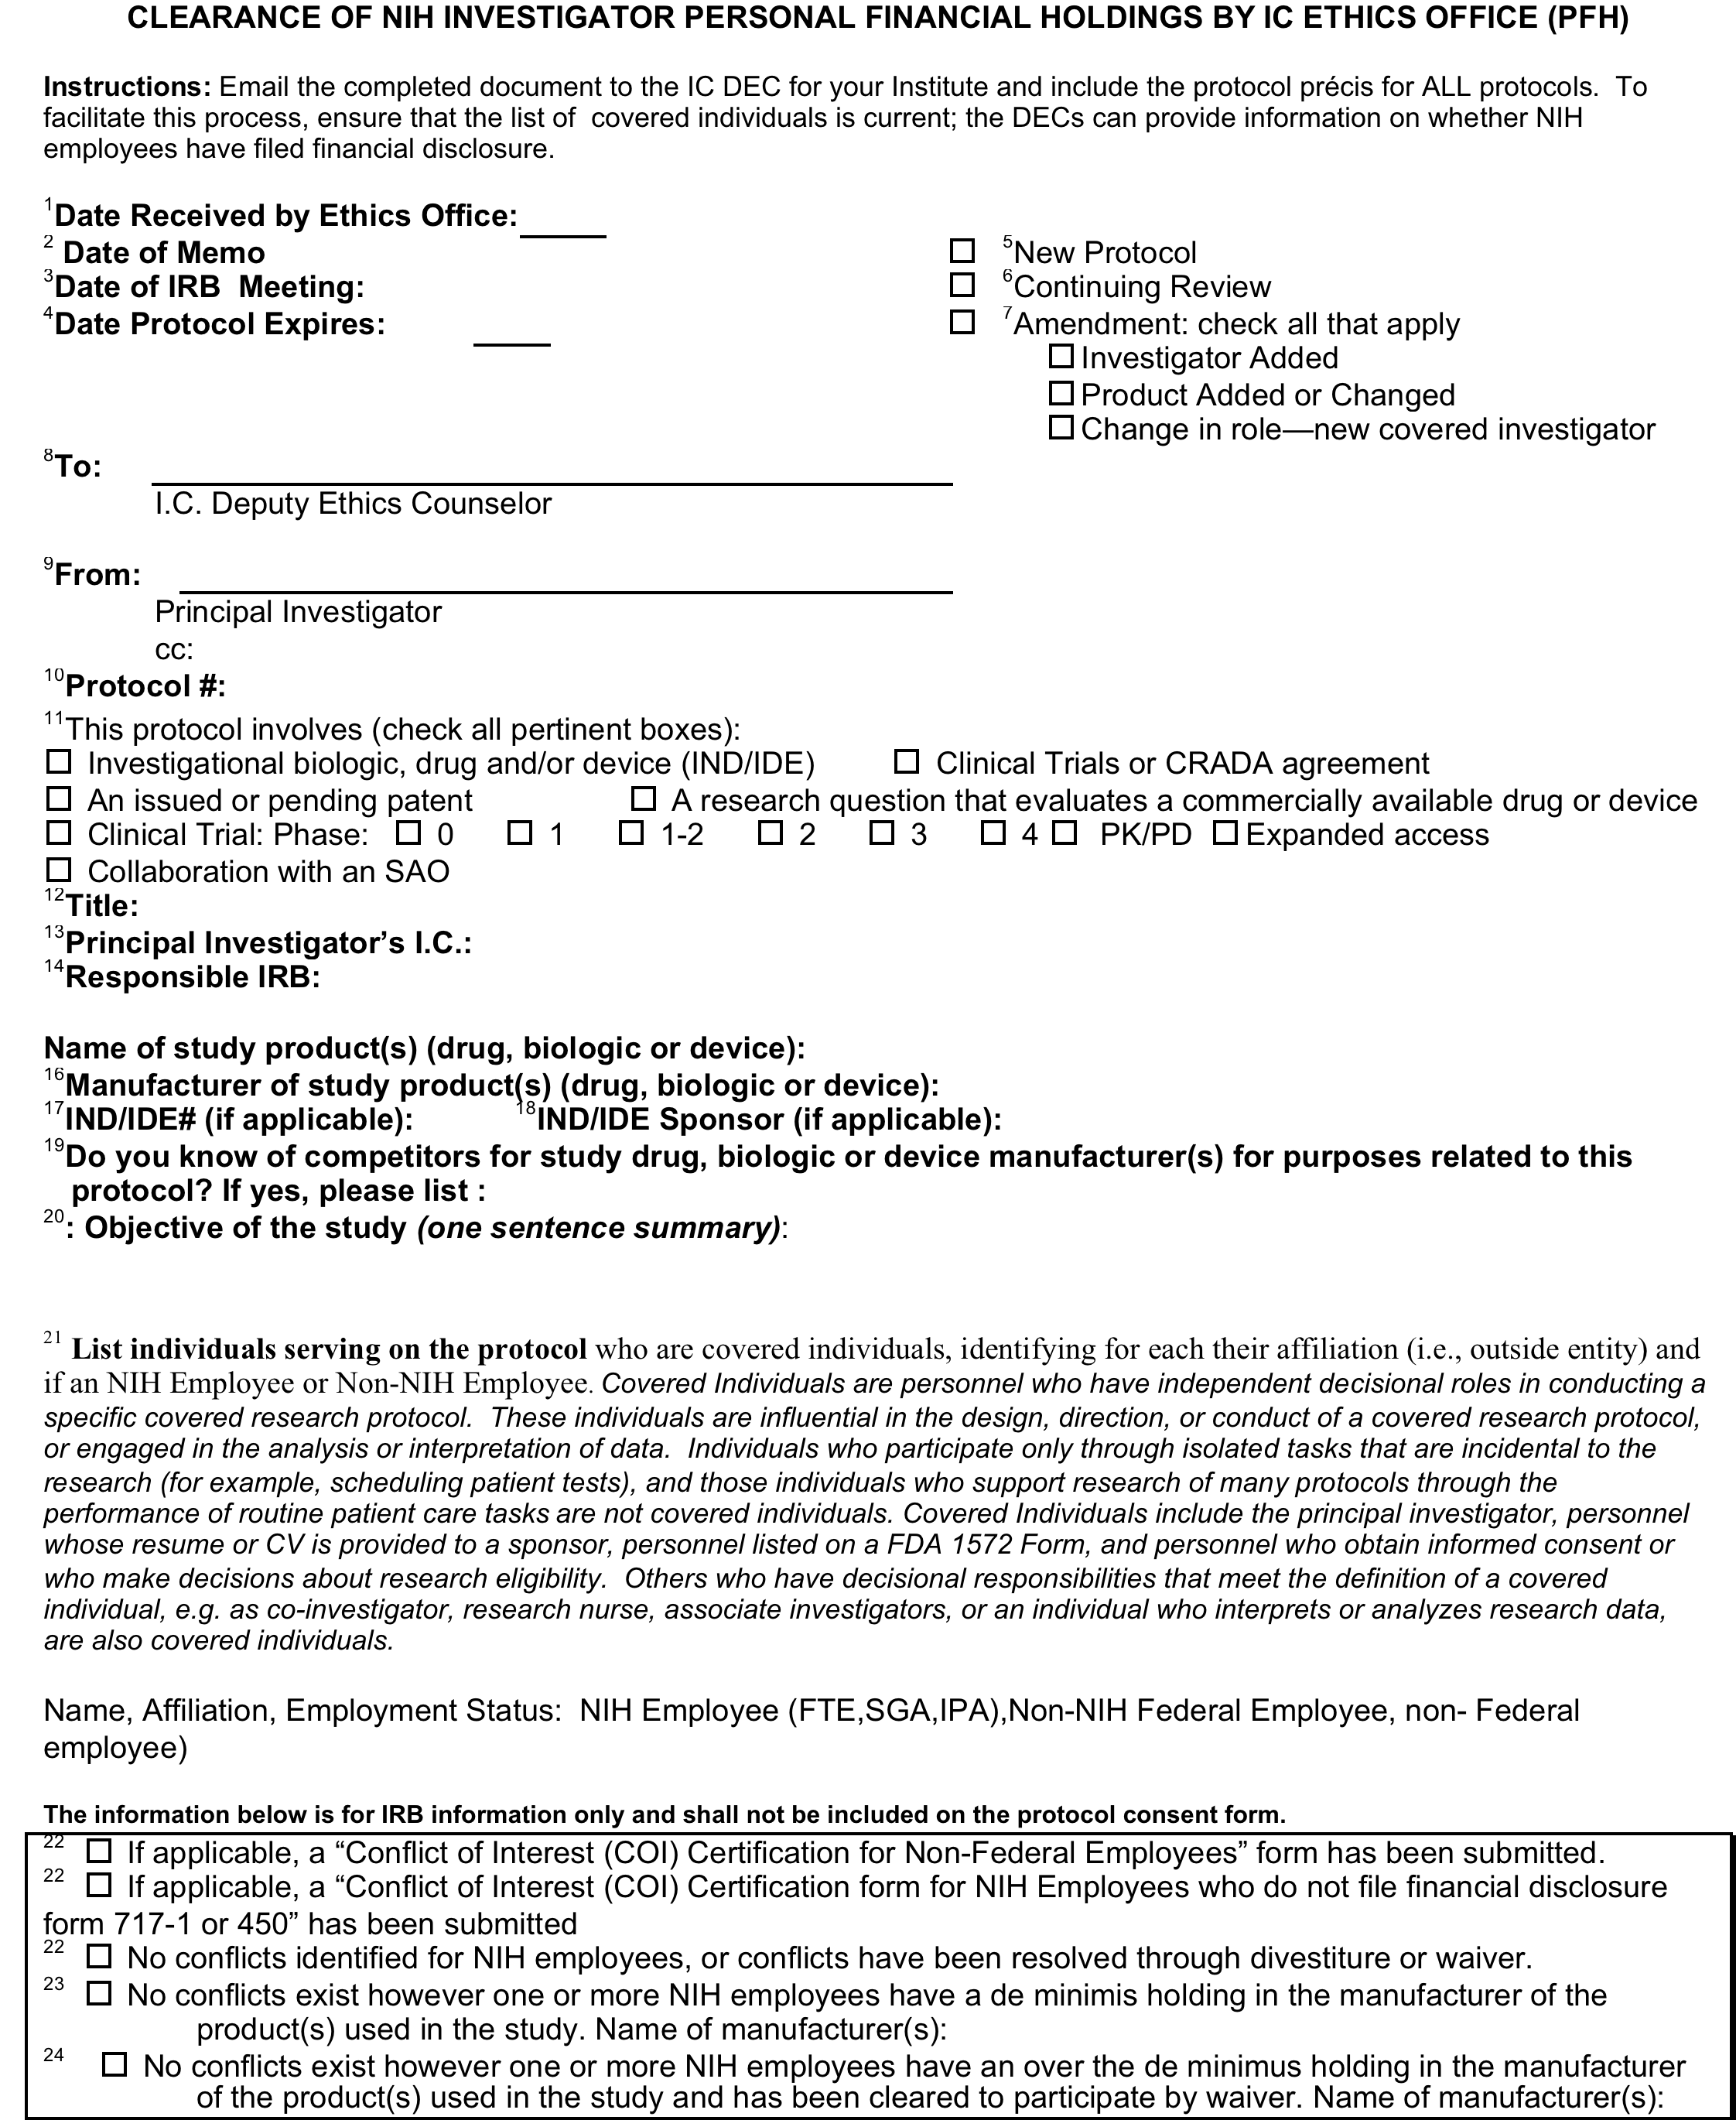
PFH Form

Slide 12
PI files PFH and certification forms with DEC
NHLBI/NCI iRISTM: will have the form programmed into the system
NIAID iRISTM: will continue to use a fillable form (and attach certifications and précis) that is uploaded within iRISTM
PTMS: users will use a fillable form and attach certifications and précis. The documents can be uploaded into PTMS, with an email asking the DEC to download them and review, or they can be emailed to the DEC.

Slide 13
Documentation of clearance by the DEC
NHLBI/NCI iRISTM and NIAID iRISTM: DECs will document their review as they do now
PTMS: DECs will email the clearance to the PI who will upload it into PTMS. (We hope that the form will be programmed into PTMS in 2014)

Slide 14
SOP 21 Appendix B: Algorithm for Decisions Regarding Financial Disclosure
Is the study a covered protocol?
Covered protocol: Assessment of financial conflict of interest is required for all clinical research protocols that may lead to the financial benefit or loss of any individual or entity . This includes studies of investigational drugs and devices, studies whose research question involves a commercially available drug or device, studies involving a CRADA or Clinical Trials Agreement, studies involving collaborations with a substantially affected organization or studies involving intellectual property. NIH research protocols that are categorized as Teaching and Training, or Natural History studies are not covered research protocols, unless they meet the criteria listed above. Most interventional protocols will be covered protocols unless the intervention does not involve the criteria listed above (e.g. a behavioral intervention might not meet the criteria for a covered research protocol).
No
Yes
No further action needed
Is the person a covered individual?
No
Yes
Is the person an NIH employee, SGE or IPA?
No
Yes
Covered Individual: Covered Individuals are personnel who have independent decisional roles in conducting a specific covered research protocol. These individuals are influential in the design, direction, or conduct of a covered research protocol, or engaged in the analysis or interpretation of data. Individuals who participate only through isolated tasks that are incidental to the research (for example, scheduling patient tests), and those individuals who support research of many protocols through the performance of routine patient care tasks are not covered individuals. Covered Individuals include the principal investigator, personnel whose resume or CV is provided to a sponsor, personnel listed on a FDA 1572 Form, and personnel who obtain informed consent or who make decisions about research eligibility. Others who have decisional responsibilities that meet the definition of a covered individual, e.g. as co-investigator, research nurse, associate investigators, or an individual who interprets or analyzes research data, are also covered individuals.
Is the person a non-NIH Federal employee?
Has the person filed a form 450 or 717?
No
No
Yes
Yes
No
File a certification of COI form for non-NIH employees
No further action needed
Submit certification of COI form for NIH employees

Slide 15
Implementation: Responsibility of IRB
IRB is not asked to “check” to be sure that the PI assignment of roles is correct
If no PFH is available for what appears to be a covered protocol, send email to PI and copy the CD
NO change in current policy regarding requirement that COI be reviewed (as applicable) before protocol proceeds

Slide 16
Thanks!

